Slide 1
DATA 2204:
Discriminant Analysis – Assignment #3
Name: Raj Dholakia
Student ID: 100813041

Slide 2
Table of Contents
Analysis Statement
Key Insights from the Pandas Profiling Report
Understanding the Learning Curve
Standard vs Optimized LDA Model
LDA vs Logistical Regression Model
What should be the next steps?

Slide 3
Analysis Statement
Develop an LDA model and evaluate its performance in comparison with a Logistical Regression model with SMOTE for the heart failure dataset and carry out additional analysis to better understand the LDA Model.

Slide 4
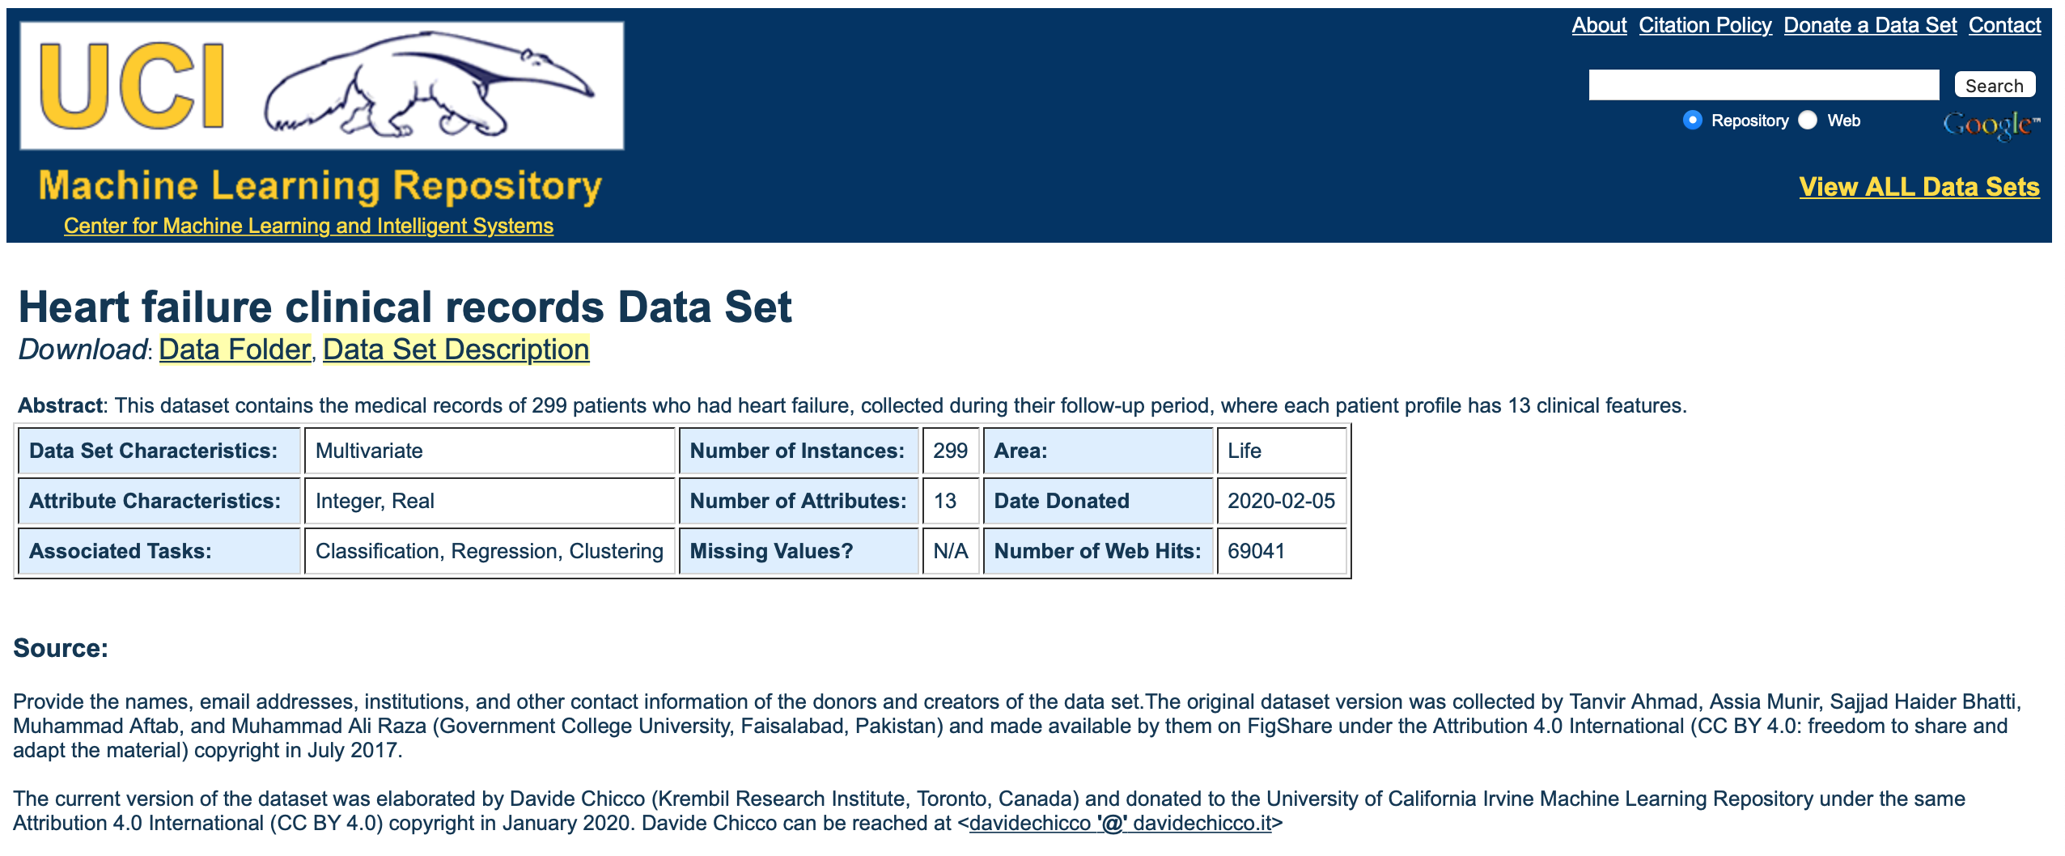
Key Insights from the Pandas Profiling Report
The dataset consists of twelve (12) independent variables and one dependent – ‘DEATH_EVENT’.
The twelve (12) independent variables are made up of six (6) numerical (NUM) variables and six (6) categorical (BOOL) variables – hence a mixed dataset.
Only three (3) out of the six (6) continuous variables have a normal distribution. The other three (3) have skewed or uniform distributions.
There are a total of 299 samples in the dataset (a small dataset) and is and contains no missing values.
There is a large imbalance in the dataset as the number of deceased patients examples are 96, while the number of alive patients are 203.
From the correlation plot, it is evident that there are very weak or no correlations between variables in the dataset. One exception could be a slight correlation between the variables `time` and `DEATH_EVENT`.

Slide 5
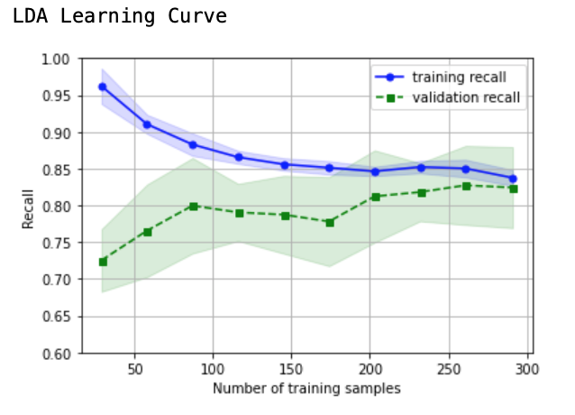
Understanding the Learning Curve
Some insights gained from the Learning Curve of the Logistical Regression Model:
The learning curve seems to be flattening after 250 samples, highlighting the possibility that more samples might not improve the performance of the model.
The model has a very low variance when trained on 300 samples.
The performance of the model is in the acceptable region of 80-85% recall. The model performance can be can work as a base model for development of other resources. This also shows that the bias in the model is at an acceptable level as well.

Slide 6
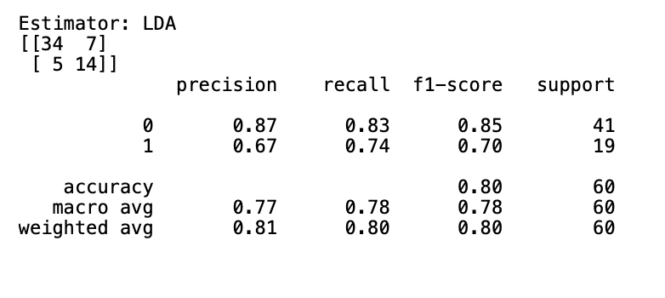
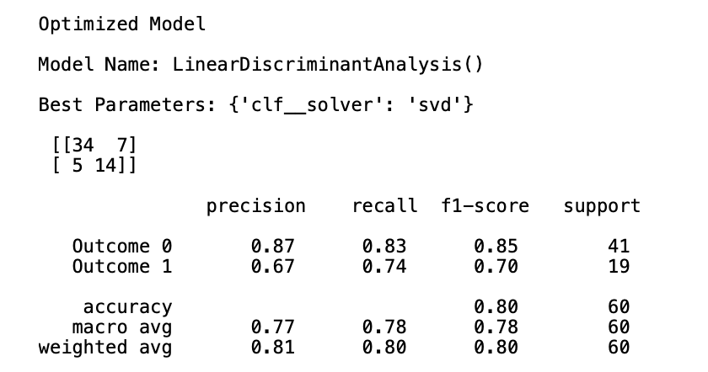
Standard vs Optimized LDA Models
Standard LDA Model:
The model has achieved an overall F1 score of 80%. As the dataset is imbalanced, the overall F1 score does not provide a holistic understanding of the model’s performance.
Considering the model’s performance for each class individually, we observe a F1 score of 85% for positive (deceased) and 70% for negative (alive) samples (patients).
There is huge discrepancy (difference of 15% in F1 scores) in the model’s performance when predicting the two different classes. One of the reasons for this discrepancy can be the imbalance in the data (mentioned in Key Features section). However, the use of SMOTE to balance the training dataset has reduced the effects of the imbalance.
The model has achieved a below average precision of 67% when predicting a positive outcome (deceased), while an outstanding 87% when predicting a negative outcome (alive).
Comparing both the models:
Both the models have achieved the same results for all the metrics – there is no difference in the model performances.
The identical performance can be underpinned from the confusion matrix, which has the same number at each corner for both the models.

Slide 7
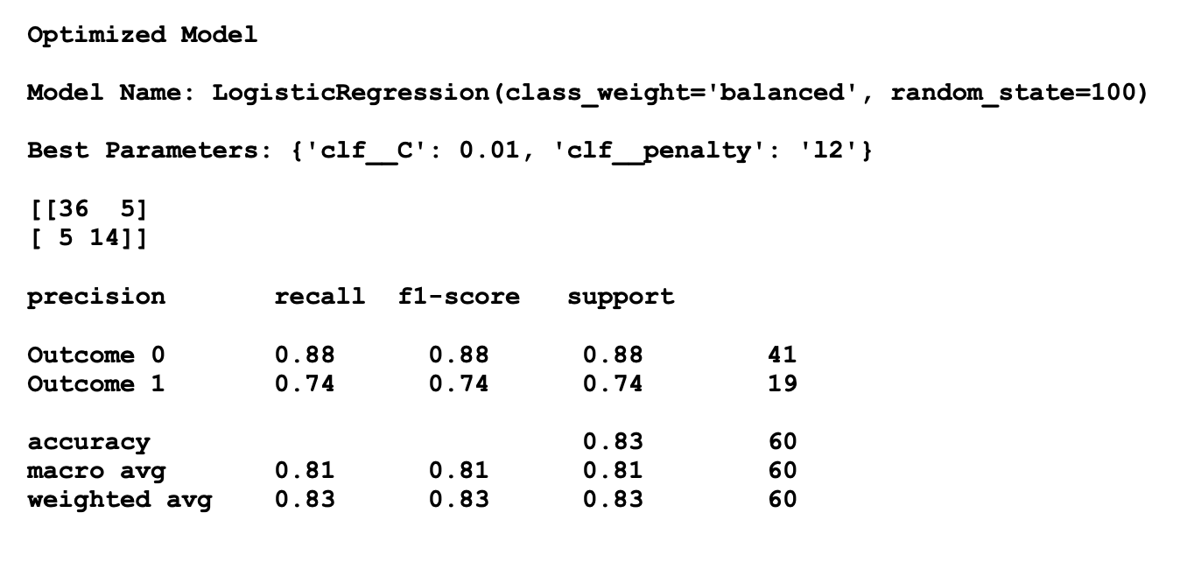
Optimized LDA vs Optimized Logistical Regression Models
Comparison:
The logistical regression model with a F1 score of 83% performs slightly better than the LDA model that achieved an F1 score of 80%.
Comparing performance of the models at predicting each of the outcomes also shows logistical regression model has a better F1 scores (88% for Outcome 0 and 74% for Outcome 1) than the LDA model (85% for Outcome 0 and 70% for Outcome 1).
Reasoning:
One of the major reasons for logistical regression performing better is the fact that the dataset used is a mixed dataset: contains continuous and categorical variables. To add to it, half of the independent variables are categorical and half are numerical. Hence, logistical regressions should outperform the LDA model significantly.
However, there logistical regression is only slightly better than the LDA. This is because all the variables in the dataset have the same covariance – supporting one of the assumptions for the LDA model. This also eliminates the possibility of a QDA model outperforming the LDA.
Finally, if all the continuous variables in the dataset had a normal distribution, the LDA model would have a similar performance to that of the logistical regression model.

Slide 8


What should be the next steps?
Mr. John Hughes can take into consideration the following options to better predict if a patient is deceased during the follow-up period (‘DEATH_EVENT’) using a LDA model:
Improving dataset structure: though SMOTE is being used to balance the dataset, synthetically improving the balance in the class samples does improve the model’s performance, but it can be better with a balanced dataset.
Using more complex algorithms: deep learning neural nets can perform well with imbalanced datasets, such as this one. Using a more complex algorithm can improve the results obtained, however, there is high chance of overfitting the dataset.
Feature selection: doing feature selection can reduce the noise for the model, improving its performance.
Notes:
John Hughes is a fictional character

Slide 9
Thank you
Raj Dholakia
raj.dholakia@dcmail.ca
Student ID: 100813041

